Slide 1


PREMIER LEAGUE WINNER PREDICTOR
By : P. Sri Ashritha
IIITDM Kancheepuram

Slide 2



PROJECT OVERVIEW
This project builds a machine learning–based web application to predict the league winner of the English Premier League (EPL) using historical season statistics. The models were trained on features such as matches played, wins, losses, goals scored, goals conceded, goal difference, and total points

Slide 3
MOTIVATION
Why Predict EPL Winners?
Predicting who will win the English Premier League (EPL) is important for a few key reasons:
Fantasy Football: It guides players in choosing the best teams for their fantasy leagues.
Team Strategy: Clubs use predictions to understand their own strengths and weaknesses, and those of their rivals, to make better decisions about players and tactics.
How ML helps in Team Strategy?
For actual football clubs, ML is like having an all-seeing analyst constantly watching every detail of their own team and every opponent. It processes: Team Performance Metrics , Player Tracking Data , Opponent Tendencies.
Using this , the ML Model can:
Identify the weakness
Highlight the strenghts
Scout Opponents

Slide 4
STEPS INVOLVED :
Define the Problem and Collect Data
Exploratory Data Analysis (EDA)
Model Selection
Train-Test Split
Model Training
Model Evaluation
Hyperparameter Tuning
Deployment

Slide 5
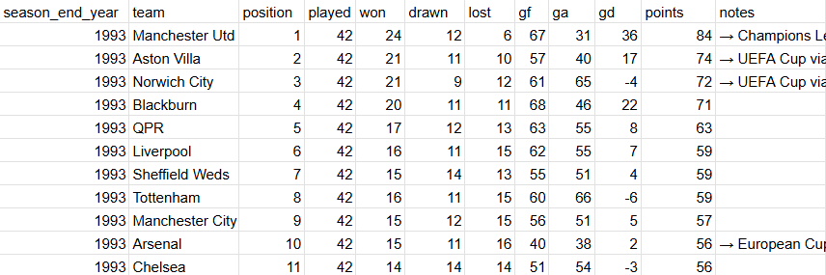
DEFINE THE PROBLEM AND COLLECT DATA
Goal:
Predict whether a team will win the Premier League based on their season statistics
Binary classification: League Winner (1), Not (0)
Data Source:
Historical Premier League tables(1993-2004)
Dataset - pl-tables-1993-2024.csv
646 total rows
12 - features

Slide 6
CHALLENGES
Highly Imbalanced Data - 5% league winners vs 95% non-winners
320 Null values
Duplicate records - Yes or No ?
Team Specific - Dominance Bias
Some features don’t add value to the prediction
Only 32 records of the target class

Slide 7
EDA - EXPLORATORY DATA ANALYSIS
Understanding the dataset structure and quality , identifying the patterns , detect correlations between features , removing unwanted features is part of EDA
Data Types - identified two object features (team ,notes)
320 missing values in ‘Notes’ column
Dropped notes column (non-essential for prediction)
Checked Duplicates - Found 0
Target Variable Creation
League Winners - marked as 1
Non-Winners - marked as 0

Slide 8
EDA - EXPLORATORY DATA ANALYSIS
Distribution Analysis - Box plot - handling outliers
Points Distribution by Winner Status
Winners: ~80-100 points (tight range)
Non-winners: 10-80 points (wide spread)
Clear separation between classes
Goal Difference (GD) Distribution:
Winners: Consistently positive GD (+30 to +80)
Non-winners: Wide range (-70 to +50)
GD is a strong discriminator

Slide 9
EDA - EXPLORATORY DATA ANALYSIS
Correlation Heatmap Analysis
High Positive Correlations:
won ↔ points: 0.973 (extremely strong)
gd ↔ points: 0.933
gf ↔ won: 0.828
High Negative Correlations:
lost ↔ points: -0.914
position ↔ points: -0.953
Multicollinearity Alert:
Multiple features measure similar concepts
May need feature selection

Slide 10
INFERENCES FROM EDA
Correlation with league_winner:
points: 0.611 - Strong positive
won: 0.573 - Strong positive
gd: 0.564 - Strong positive
lost: -0.497 - Strong negative
drawn: 0.089 - Weak
Insight: Wins, points, and goal difference are best predictors
Dropped Features:
season_end_year (temporal but not used as feature)
team (redundant after analysis)
position (target leakage - determines winner)
points (too directly related to winning)

Slide 11
MODEL SELECTION
Why These Algorithms?
Random Forest Classifier:
Handles non-linear relationships well
Robust to outliers
Provides feature importance
Less prone to overfitting than single decision trees
Neural Networks:
Can learn complex patterns
Flexible architecture
Good with scaled numerical data
Potential for higher accuracy with proper tuning
Models Impemented:
Random Forest Classifier (Baseline)
Random Forest + SMOTE (Imbalanced data handling)
Neural Network + SMOTE (Deep learning approach)

Slide 12
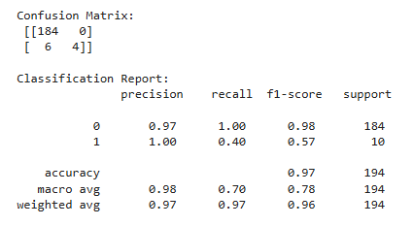
MODEL 1 - BASELINE RANDOM FOREST
Results:
Accuracy: 96.91%
Precision: 100% (no false positives)
Recall: 40% (missed 6 out of 10 winners)
F1-Score: 0.57
Analysis:
High accuracy misleading due to class imbalance
Very conservative predictions (avoids false alarms)
Poor recall - fails to identify most winners
Too cautious, misses majority of positive class
RandomForestClassifier(n_estimators=200, random_state=42)
Train-Test Split: 70-30, stratified

Slide 13
ADDRESSING CLASS IMABALANCE - SMOTE
Challenge: 95% non-winners, 5% winners
SMOTE Solution:
Synthetic Minority Over-sampling Technique
Creates synthetic examples of minority class
Balances training data
Tested Strategies:
sampling_strategy = 0.3 ✓ (Best)
sampling_strategy = 0.5
sampling_strategy = 0.7
Optimal Choice: 0.3 (balanced performance)

Slide 14
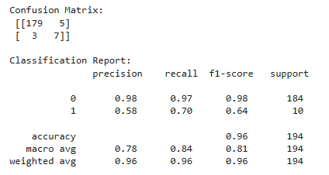
MODEL 2 - RANDOM FOREST + SMOTE
Results:
Accuracy: 95.88%
Precision: 58.3% (some false positives)
Recall: 70% (caught 7/10 winners) ✓ Improved
F1-Score: 0.64
Analysis:
Slight accuracy drop, but better balance
Recall improved from 40% → 70%
More practical for identifying winners
Identifies 70% of winners (7/10) vs 40% before
5 false alarms (acceptable trade-off)
Better balance between precision and recall
SMOTE(sampling_strategy=0.3, random_state=42)
RandomForestClassifier(n_estimators=200, random_state=42)

Slide 15
MODEL 3 - NEURAL NETWORK ARCHITECTURE
Training Configuration:
Optimizer: Adam
Loss: Binary Crossentropy
Epochs: 20 , Batch Size: 16
Data: StandardScaler + SMOTE (0.3)
Layer 1: Dense(32, activation='relu', input_shape=7)
Layer 2: Dense(16, activation='relu')
Layer 3: Dense(1, activation='sigmoid') # Binary output
Preprocessing:
Normalizes features to similar scales
Critical for neural network convergence
Training Progress:
Epoch 1: 46.6% accuracy → Epoch 20: 95%+ accuracy
Loss decreased from 0.71 → 0.09
Stable convergence, no overfitting signs
StandardScaler().fit_transform(X_train_smote)

Slide 16
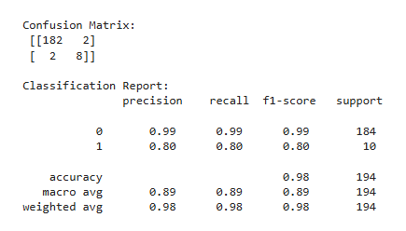
MODEL 3 - NEURAL NETWORK RESULTS
Performance:
Accuracy: 97.93%
Precision: 80%
Recall: 80% (caught 8/10 winners)
F1-Score: 0.8
Unlike baseline RF (100% precision, 40% recall), this model doesn't sacrifice one metric
F1 of 0.8 shows reasonable balance between being cautious and catching winners

Slide 17
MODEL SELECTION DECISION
Primary Model (Deployed):
Neural Network + SMOTE
Highest balanced F1-score (0.80)
Best balanced performance
Saved as: nn_smote_model.keras
Backup Model:
Random Forest + SMOTE
Higher recall (better for catching winners)
More interpretable
Saved as: rf_smote_model.pkl
Scaler: Saved as scaler.pkl for deployment

Slide 18
HYPERPARAMETER TUNING CONSIDERED
Random Forest:
Tested n_estimators: 200 (optimal)
Default settings worked well
SMOTE:
Critical tuning: sampling_strategy
Tested: 0.3, 0.5, 0.7
Result: 0.3 gave best recall without overfitting
Neural Network:
Architecture: 32→16→1 neurons
Activation: ReLU (hidden), Sigmoid (output)
No extensive GridSearch (limited data)

Slide 19
CROSS-VALIDATION STRATEGY
Train-Test Split:
70% training (452 records)
30% testing (194 records)
Stratified split (maintains 5% winner ratio)
Why Not K-Fold CV?
Only 32 positive examples total
K-fold would give ~6 winners per fold
Too few for reliable validation
Single stratified split more stable

Slide 20
EVALUATION METRIC CHOICE
Why Not Just Accuracy?
95% accuracy by predicting all "not winner"
Misleading for imbalanced data
Chosen Metrics:
Recall - Catch actual winners (most important)
Precision - Avoid false alarms
F1-Score - Harmonic mean (overall balance)
Goal: Don't miss potential winners, even if some false positives occur

Slide 21
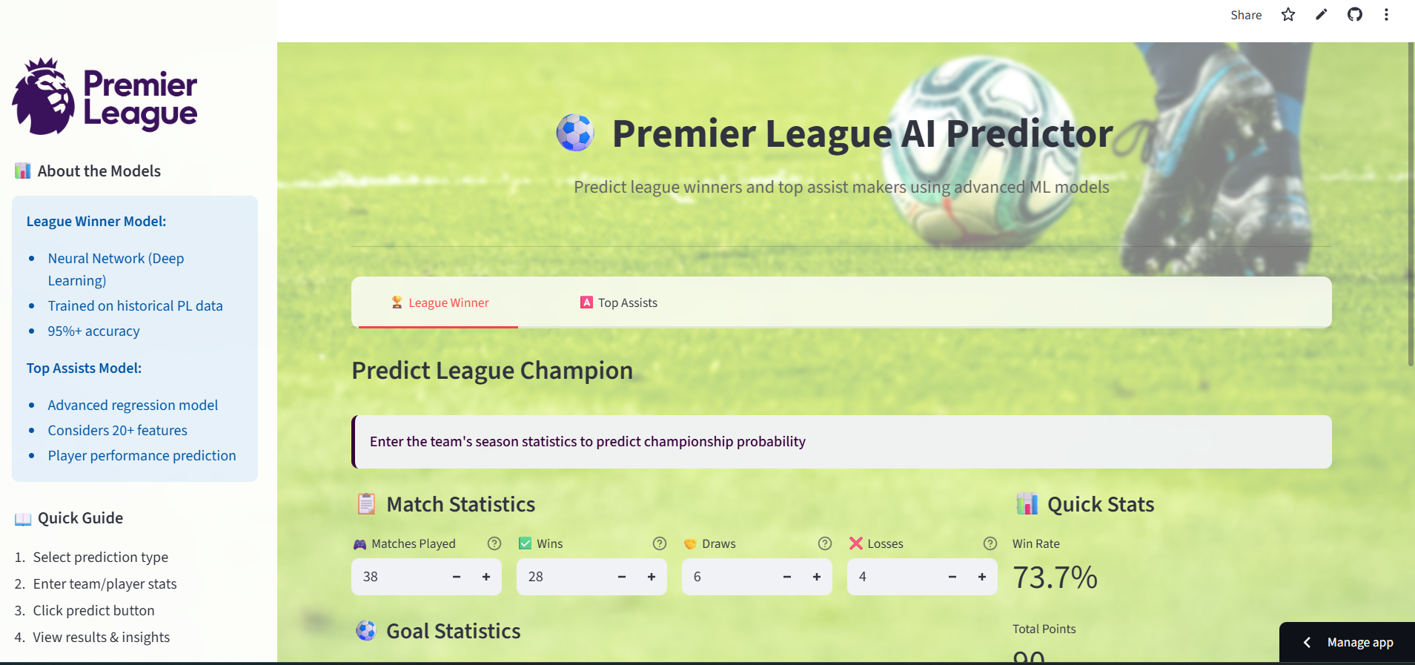

CONCLUSION
Model selection prioritized practical performance over raw accuracy. The Neural Network with SMOTE achieved the best balance between catching actual winners (recall) and avoiding false alarms (precision), making it suitable for real-world Premier League prediction despite the challenging imbalanced dataset.The model's true value lies not in perfect predictions, but in providing data-driven insights to inform human decision-making in fantasy sports, betting analytics, and sports media contexts.

Slide 22


THANK YOU

